Slide 1
National Parks Builder - Group 2
Prepared By: Maaz Ahmed, Bryan Gutierrez, Ammar Idrees, Zaid Patel

Slide 2
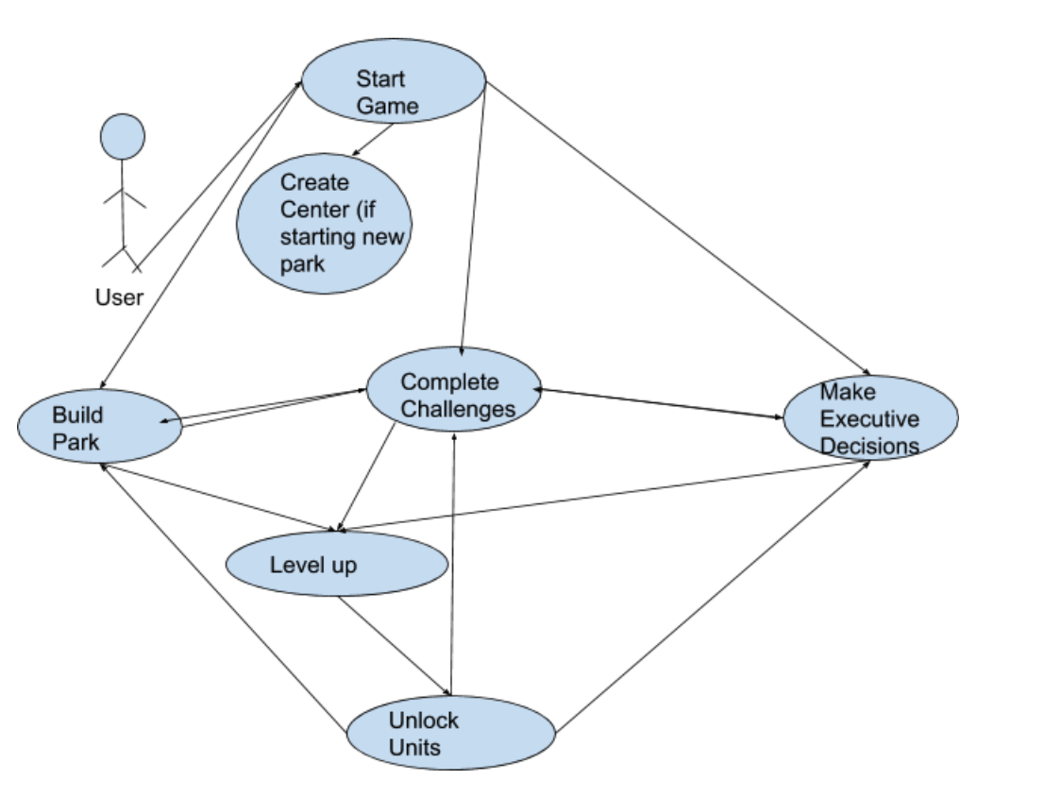
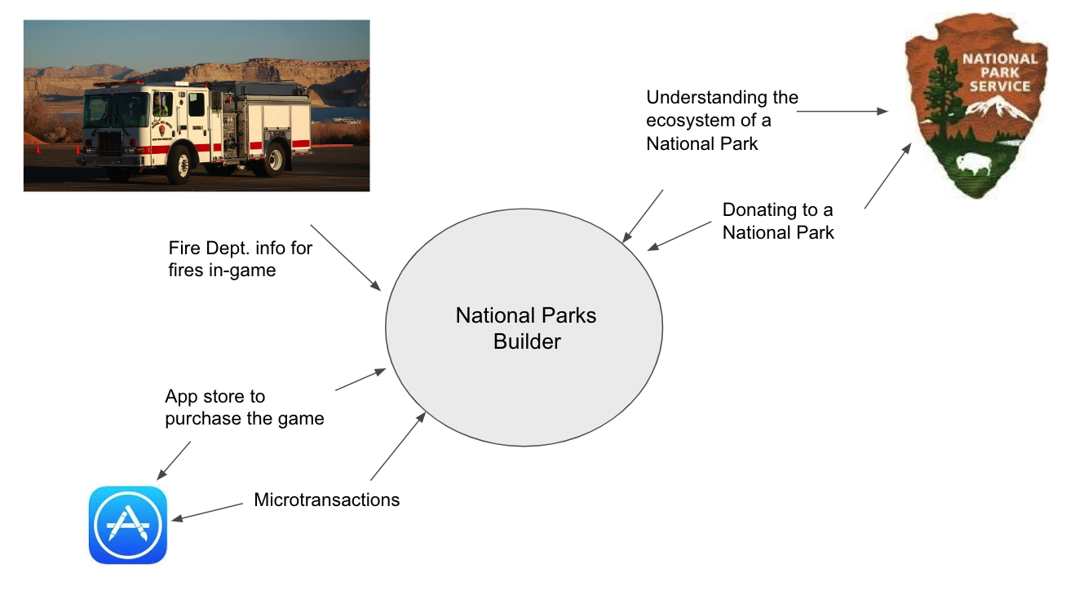
Recap
Idea: Gaming application where you can build a national park from scratch
Purpose: Give the users entertainment while having them acquire an appreciation for the Nationals parks
Goals: Increase visitors for National Parks, profit, employee morale and reduce incidents
Client Focus: National Parks Foundation, Smartphone gamers
Platform: A mobile application

Slide 3
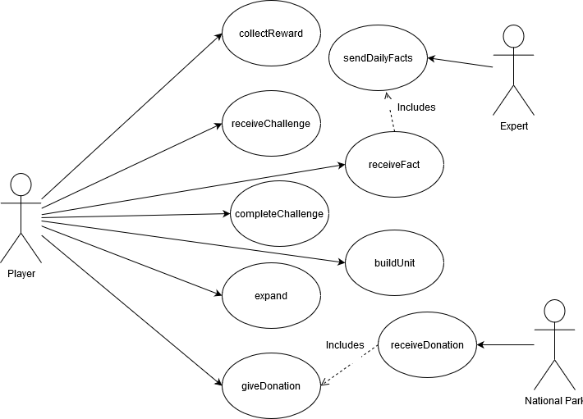
Requirements Plan
Functional Requirements: Provide rewards, display challenges, expand park, donate to charitable causes, etc.
Performance Requirements: Must load game and environment quickly, easily readable and clear font
Dependability Requirements: Server should save users data in case of a crash, should be available 24/7
Security Requirements: Need to access users personal payment information, wifi access, give data update access

Slide 4
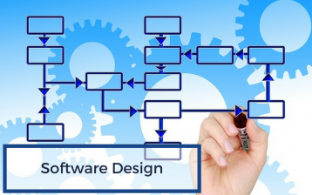
Design Goals
The design will be clearly visible and outlined
Avoid blending
Majority of screen will be the actual game
Buttons to access other options
Building
Alerts
Activities
All building types should be easily distinguished

Slide 5
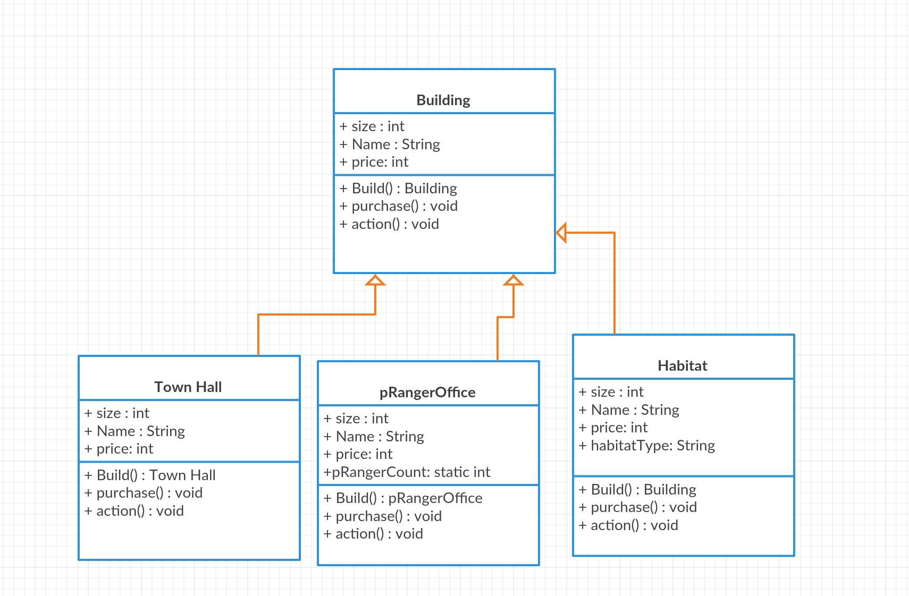
Design Cont. (UML class diagram)
Buildings are an essential part of the game
Town Hall
pRangerOffice
Habitat
Hospital
etc.

Slide 6
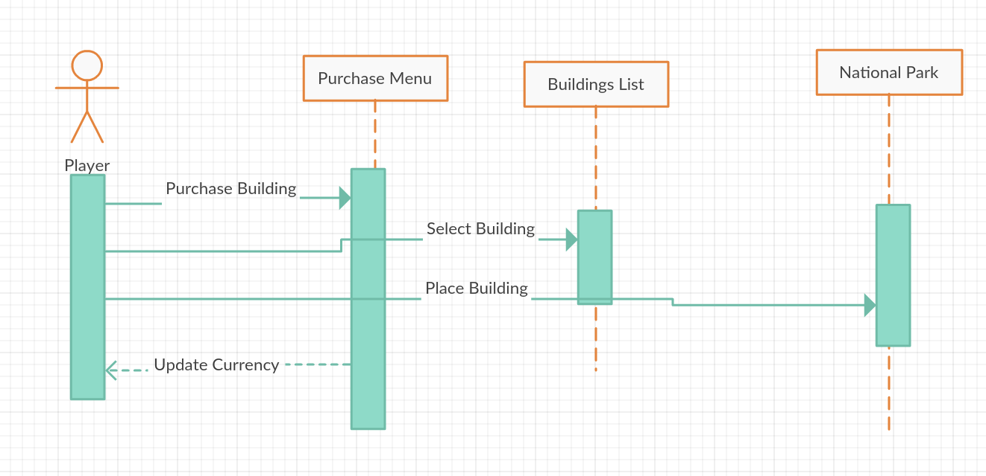
Design Cont. (Sequence Diagram)
Purchasing a new Building

Slide 7
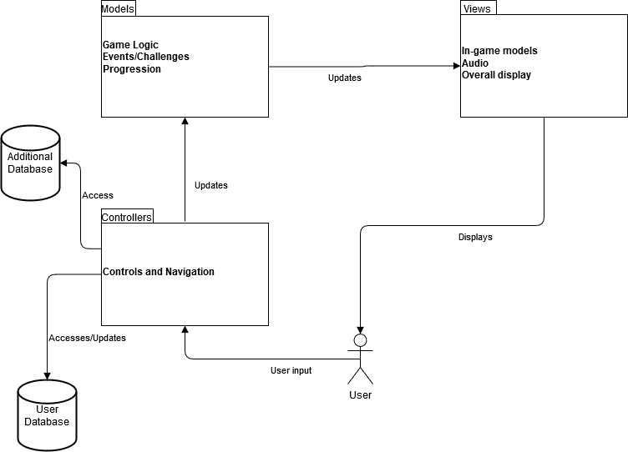
Final System Design
MVC
Has its advantages
Development
Updates

Slide 8
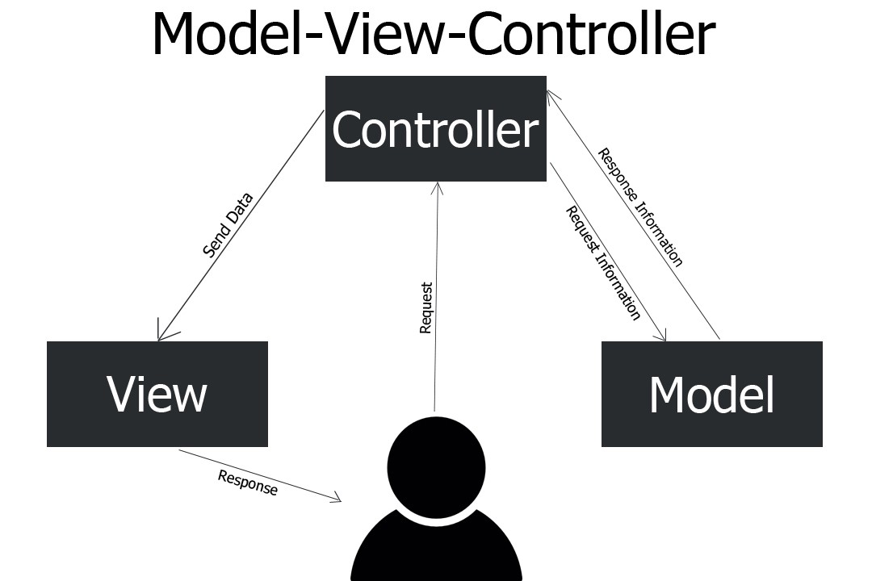
Final System Design Cont.
Controller
Basically listen for events to occur
Model
Contain the application data
This data will update the view over time
View
Display models to users
Audio
Text to notify user
User Database
Account info mainly, but can also be used to store other data...
Additional Database (possibly)
Transaction data, terrain data, and other potential uses

Slide 9
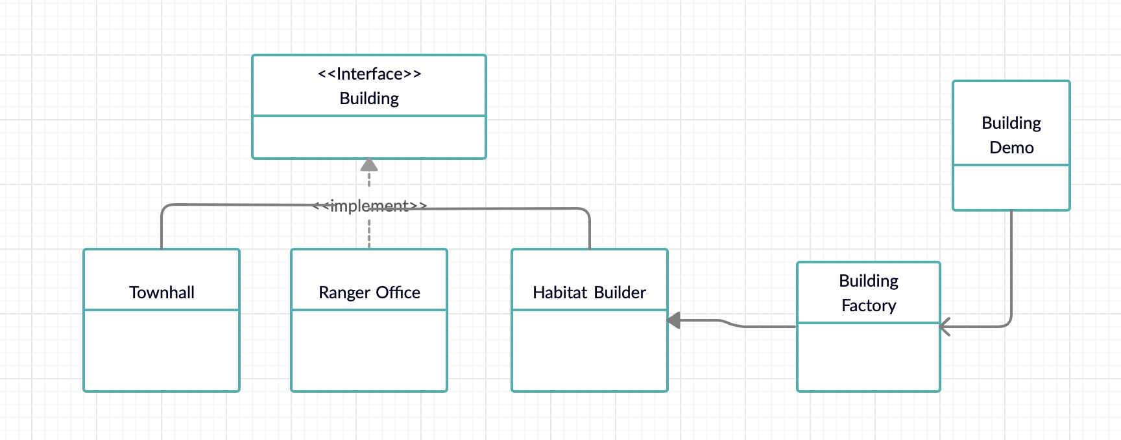
Classes and relationships
Building Interface: Would hold methods such as purchasing land, moving objects, selling objects, park health.
Townhall /ranger office/ Habitat building class: Each class will implement the building interface, but will have specific methods unique to themselves. For example, the habitat building will have methods to build forestry throughout the map.
-Could utilize factory pattern

Slide 10
Implementation of the Project
Project Retrospective
Overall we expect to implement the project with Unity or Pygame.
MySql could be utilized for the database aspect of the application
Amazon Web Service could be used to save game data.
As a team, we worked effectively together by evenly dividing up the work
Discussed as a group how we wanted to complete each section beforehand so everyone was on the same page and documentation stays consistent in terms of the approach
In conclusion this project was implemented to create an entertaining application while having the ability to bring awareness to National Parks.
The application will give users the ability to run a National Park so they become aware of all the difficulties, and budget constraints that all the parks face.

